Slide 1

MINOR PROJECT
Guide CHAT BOT
Submitted by:
Shruti Verma
Devershi Vashistha
Shrey Somwanshi
Guided by:
Mr. Titu Singh Arora

Slide 2
OBJECTIVE
The objective is to build a chat bot which is capable to have a fluent conversation with a user using Artificial Intelligence and also help the user in providing details regarding locations, their time zones, details of that locations and even mark it on the map for the user.
And even though these are the features we are currently adding to the bot, there is no limit to what amount of features we can add to it.

Slide 3
FEATURES
The Chatbot or Guide bot will have many features such as:
Chit chat
Telling Time of any location
Giving details about any locations
Marking the location of maps
Having voice conversation with the bot

Slide 4
RASA FRAMEFORK
Rasa is an open source machine learning framework for automated text and voice-based conversations. Understand messages, hold conversations, and connect to messaging channels and APIs.
Rasa is a tool to build custom AI chatbots using Python and natural language understanding (NLU). Rasa provides a framework for developing AI chatbots that uses natural language understanding (NLU). It also allows the user to train the model and add custom actions."

Slide 5
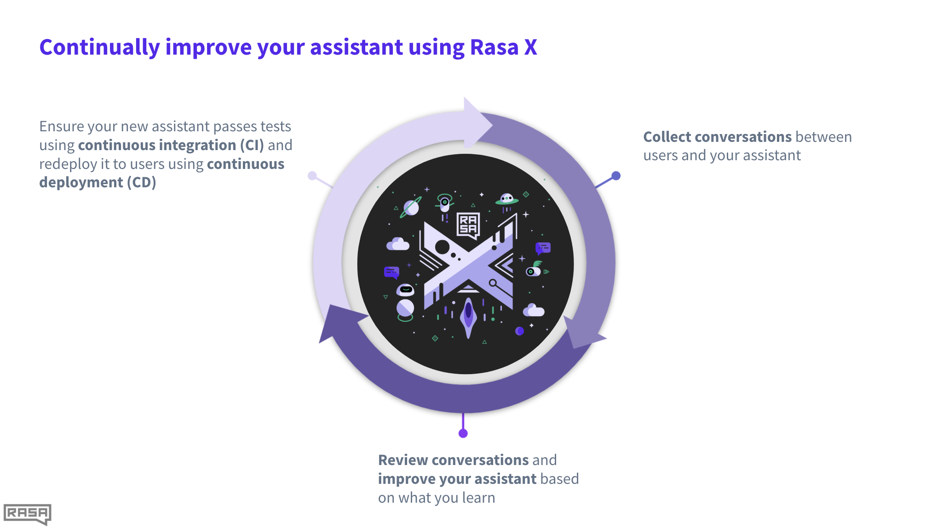
RASA X
Rasa X is a free toolset used to improve virtual assistants built using Rasa Open Source. Together, they include all the features to create powerful text- and voice-based assistants and chatbots.

Slide 6
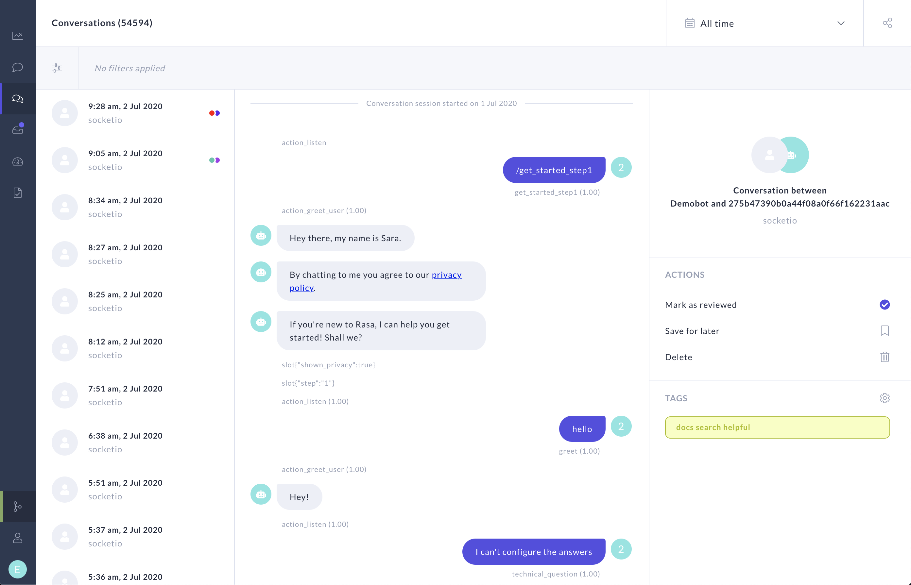

Slide 7


